Slide 1
Wargaming Operational Art
The design of the Generic Low Operational Wargame system (GLOW)

Slide 2
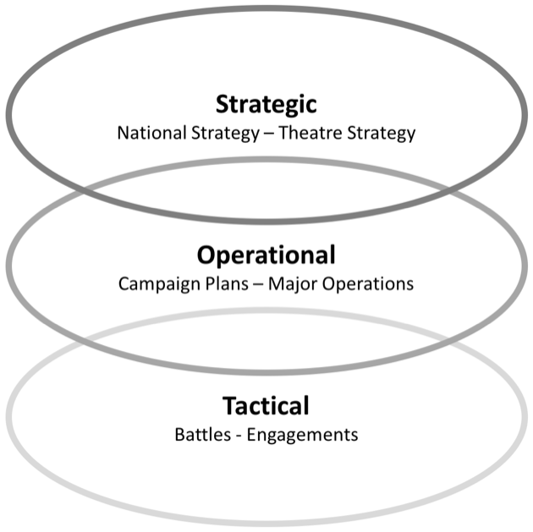
Operational Level of Warfare
Strategic level (Months to Years)
  Theatre lift and power projection
  State diplomacy and governmental policy
  R&D and manpower
Operational level (Days to Months)
  Logistics and Sustainment
  Force structures and employment
  Joint planning and the wider context.
Tactical level (Hours to Days)
  Weapon and vehicle characteristics
  Command and control
  Courses of action and planning

Slide 3
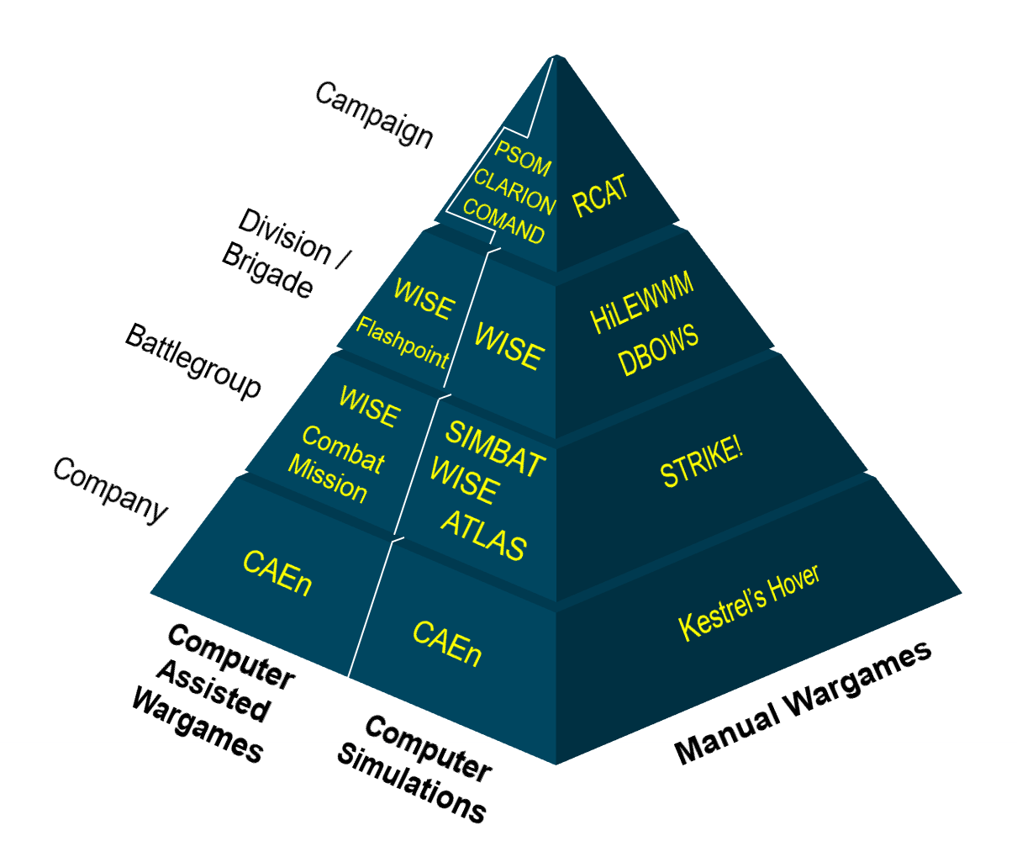
Pre-2022 Land Wargaming Pyramid
Historical bias towards tactical wargaming
Internal research highlighted the need for an analytical, low operational game

Slide 4
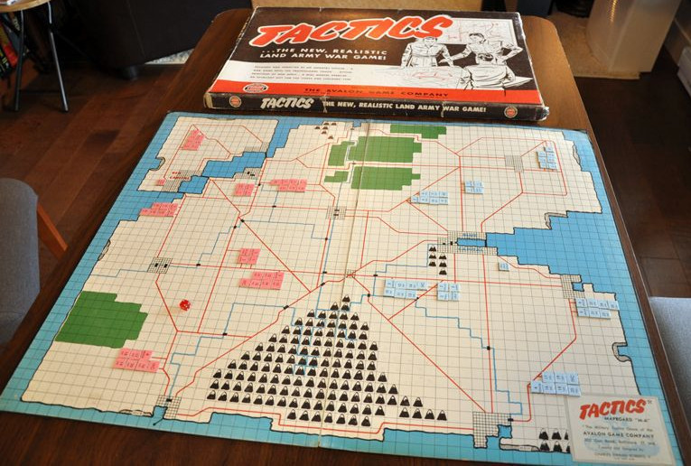
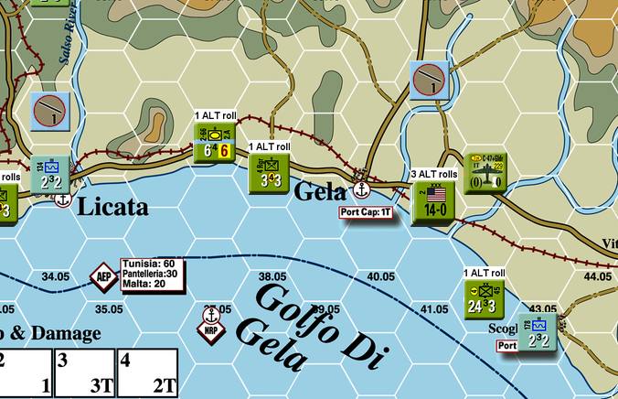
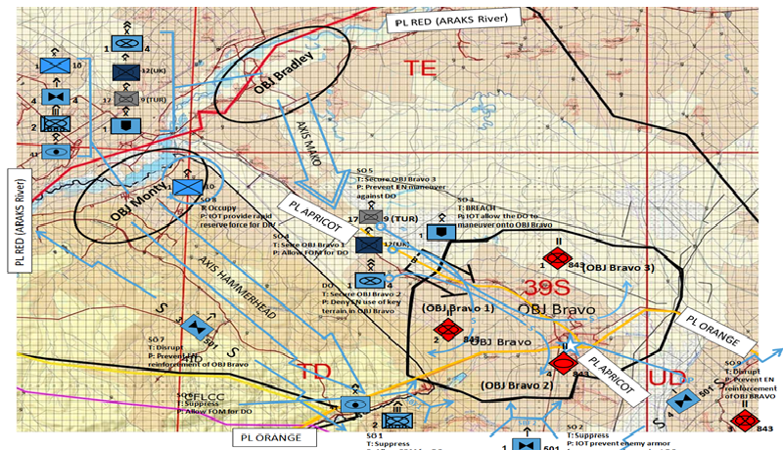
Existing Operational Wargames
Many examples of commercial operational wargames
Few professional, analytical examples in this low operational space
Wargamerx - Own work, CC BY-SA 4.0
Kurzon - Own work, Public Domain
MDMPwizard - Own work, CC BY-SA 3.0

Slide 5
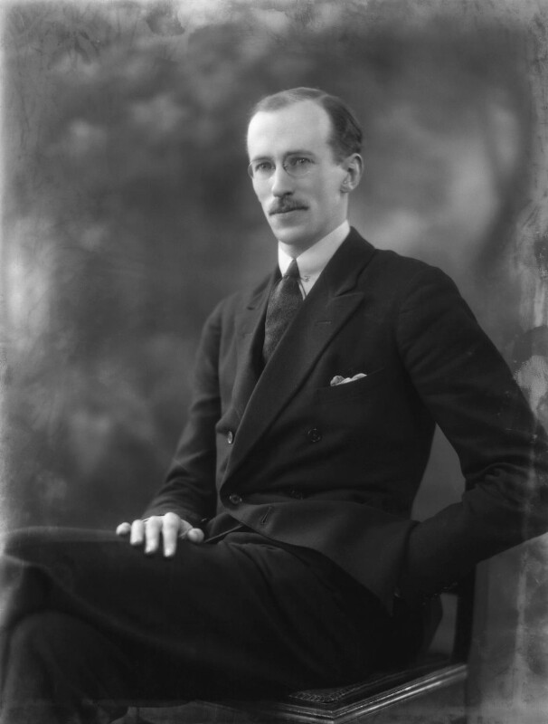
Philosophy: The Indirect Approach
“Hence his true aim is not so much to seek battle as to seek a strategic situation so advantageous that if it does not of itself produce the decision, its continuation by a battle is sure to achieve this. In other words, dislocation is the aim of strategy; its sequel may be either the enemy’s dissolution or his easier disruption in battle”
  Liddell Hart, Strategy (1954)
Bassano Ltd - Public Domain

Slide 6
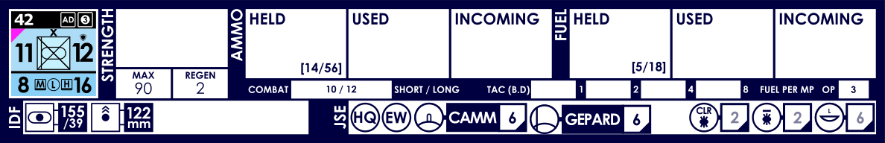
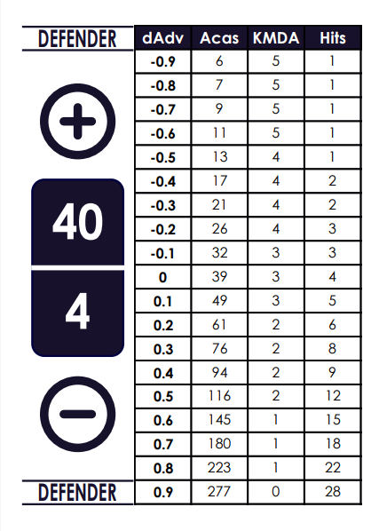
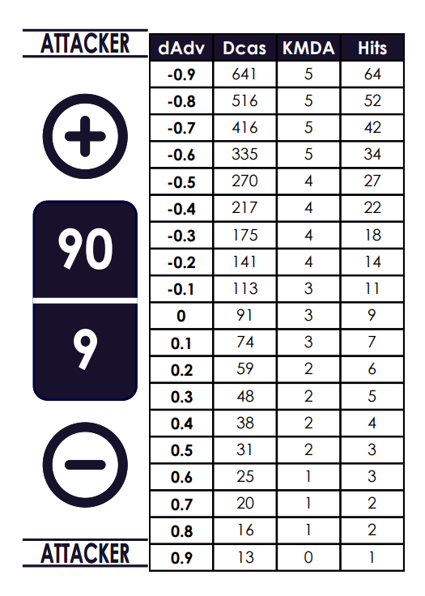
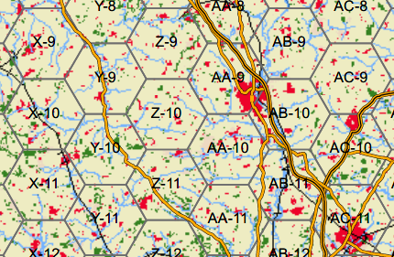
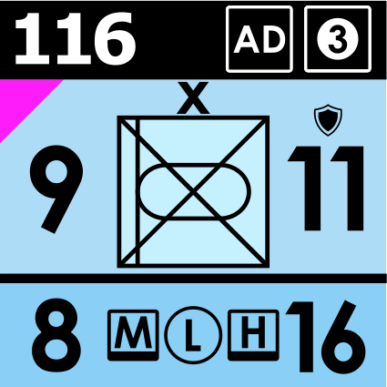


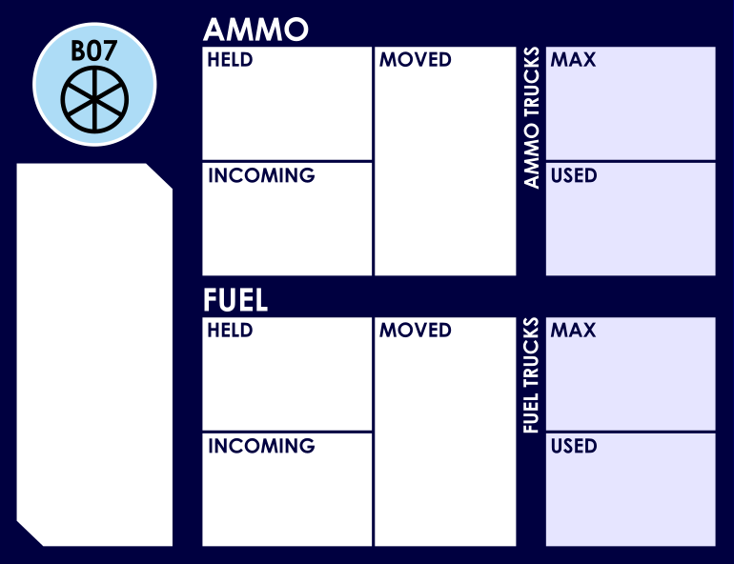
GLOW
24 hours turns
10km hex scale
Primary Land manoeuvre units are Brigades and Regiments
Off-map representation of units and nodes allows for targeting of specific enablers

Slide 7



Three Pillars of GLOW
LOGISTICS
STRIKE
BATTLE
Operational Research
Modelling
Historical Analysis

Slide 8
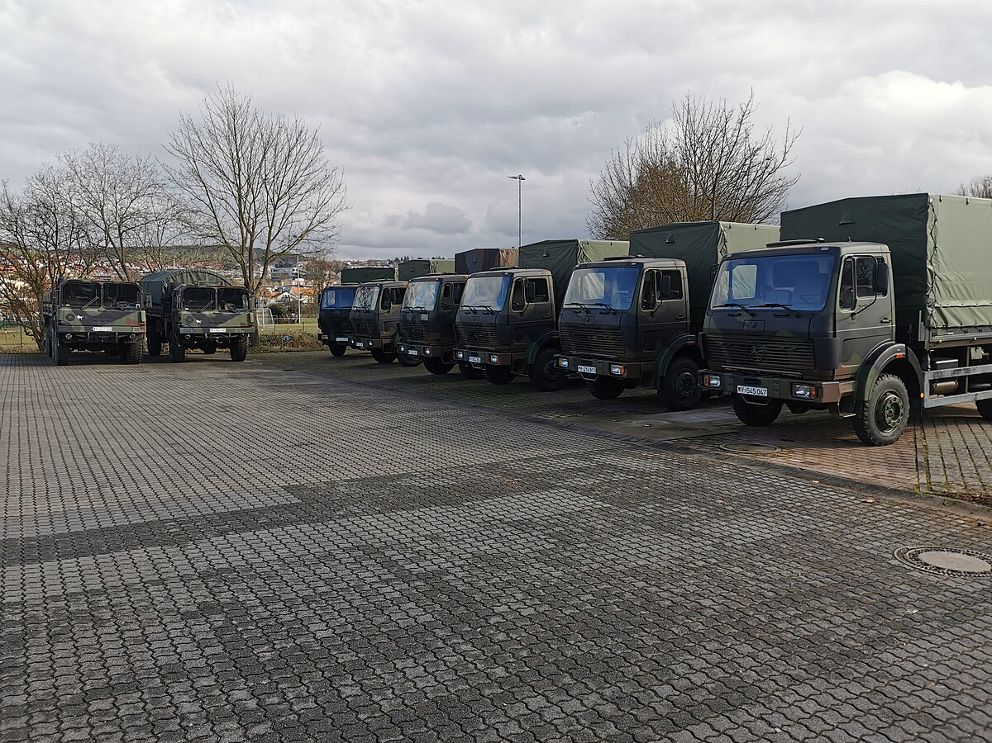
Logistics
Explicit representation
Consumption rates derived from operational research
Raw tonnage delivered by truck round-trips
Dynamically adapting logistics network
Triplec85, CC BY-SA 4.0

Slide 9
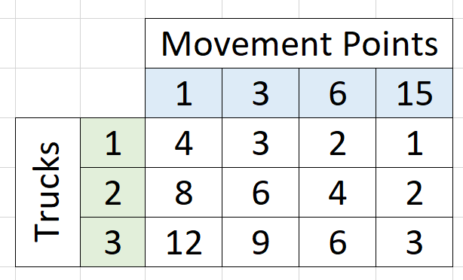

Logistics
Load + Unload = 2 hours
Round Trip = 2 hours
3 trips per day = 30 tons / truck
Example Truck
10 metric tons load
1 hour load
1 hour unload
30km/hr on-road speed
12 driver hours/day
30km – 1 hour transit
Load + Unload = 2 hours
Round Trip = 4 hours
2 trips per day = 20 tons / truck
60km – 2 hour transit
150km – 5 hour transit
Load + Unload = 2 hours
Round Trip = 10 hours
1 trips per day = 10 tons / truck

Slide 10
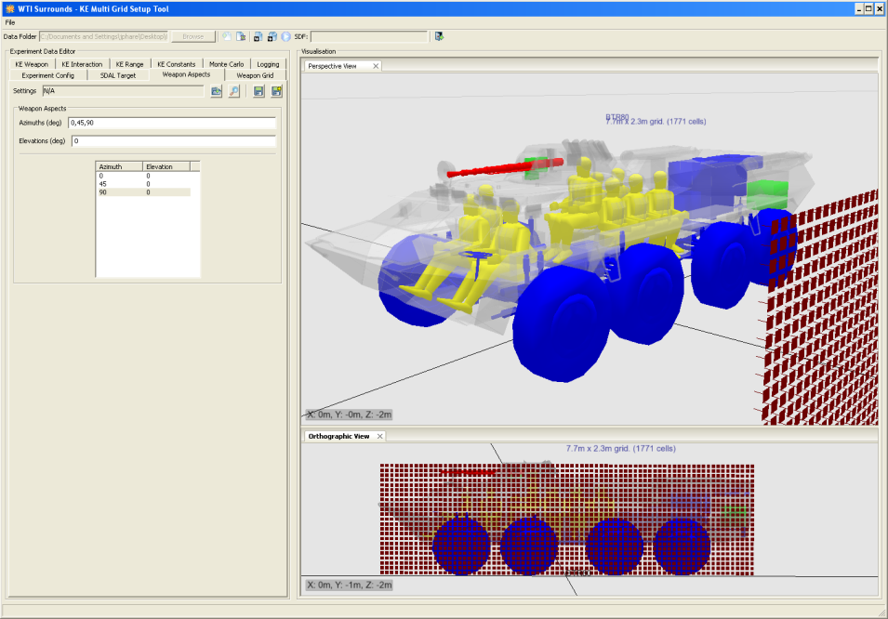
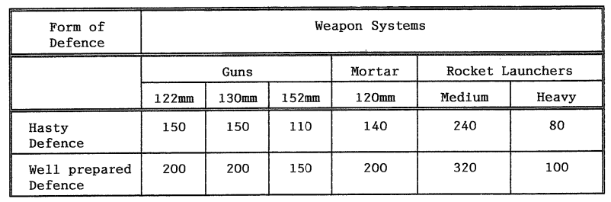
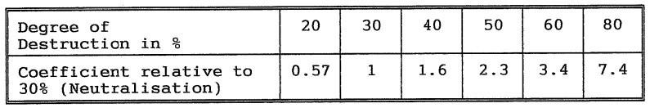
Strike
Strikes versus enablers based on data from computer modelling
Strikes versus formation strength is derived from Soviet combat model (Calculating Combat Outcomes, CW Blandy)

Slide 11
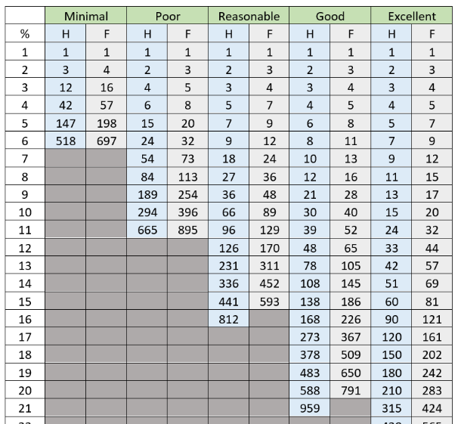
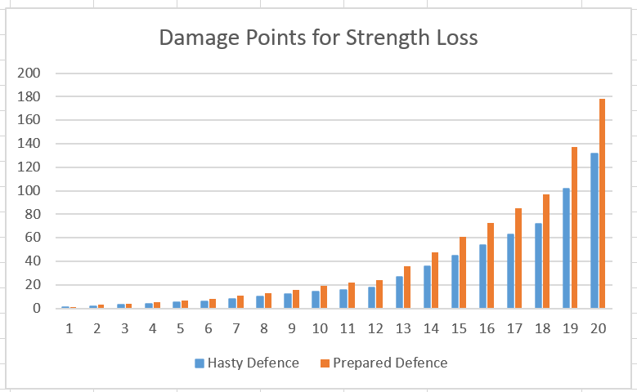
Strike
Soviet model for artillery norms against platoon-sized positions
Exponential damage curves accumulate over the turn from multiple sources

Slide 12
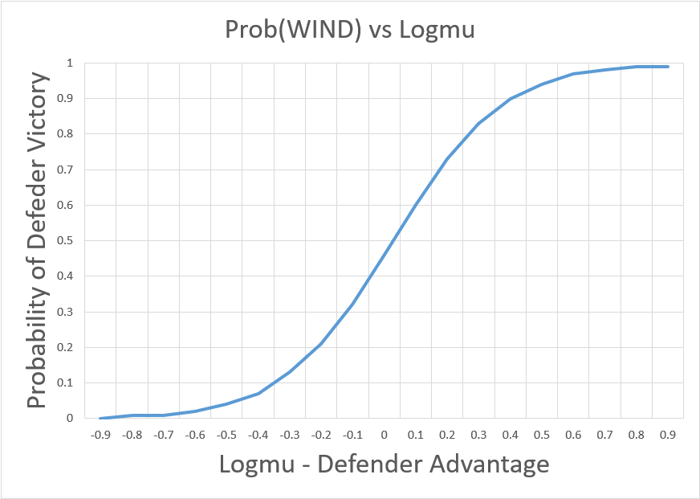
Battle
Combat system based on Helmbold battle parameters, logistic regression of CBD90 dataset
Combat modifiers from additional historical analysis

Slide 13
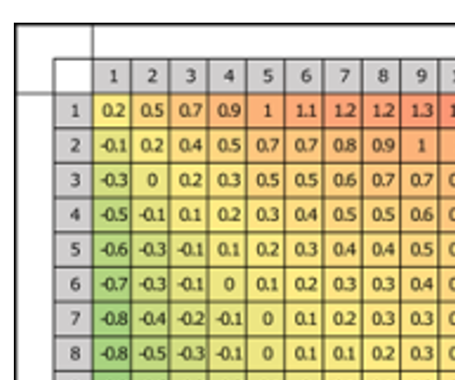
Battle
The termination problem in combat modelling: no-one knows when people stop fighting
Card system for independent bids of dynamic breakpoints

Slide 14
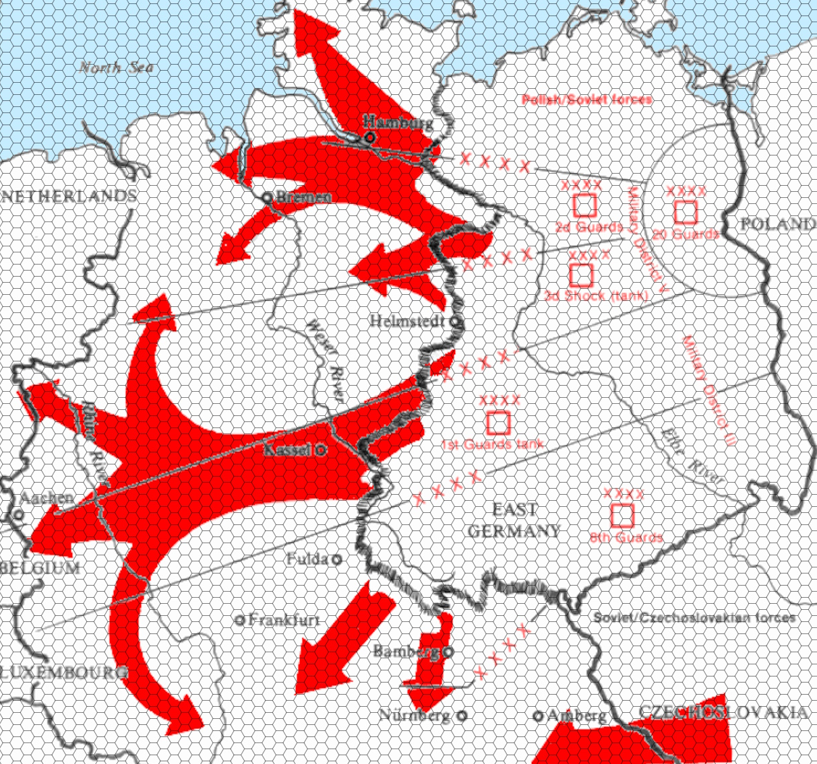
Questions
Graham H. Turbiville, Public Domain

Slide 15

The contents include material subject to © Crown copyright (2025), Dstl.
This information is licensed under the Open Government Licence v3.0. To view this licence, visit https://www.nationalarchives.gov.uk/doc/open-government-licence/
Where we have identified any third party copyright information you will need to obtain permission from the copyright holders concerned.
Any enquiries regarding this publication should be sent to: centralenquiries@dstl.gov.uk

